Slide 1
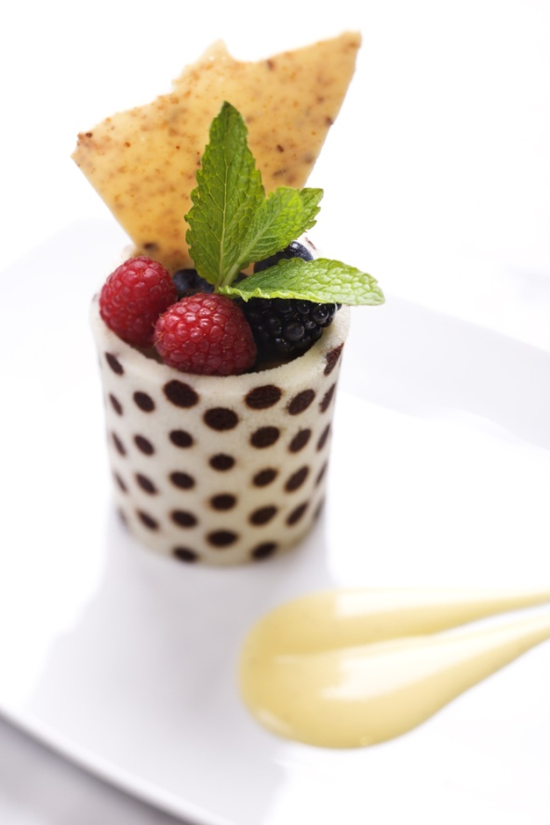
PREPARE HOT, COLD AND FROZEN DESSERT
D1.HCC.CL2.14
Notes:
Trainer to welcome students to class

Slide 2
Prepare hot, cold and frozen dessert
Assessment for this Unit may include:
Oral questions
Written questions
Work projects
Workplace observation of practical skills
Practical exercises
Formal report from employer/supervisor
Notes:
Trainer advises students that assessment for this Unit may take several forms all of which are aimed at verifying they have achieved competency for the Unit as required.
Trainer indicates to students the methods of assessment that will be applied to them for this Unit.

Slide 3
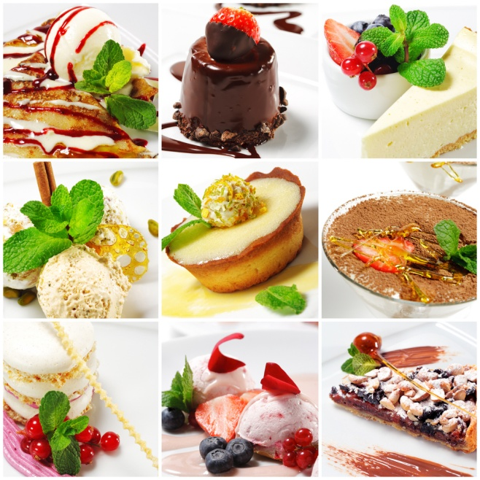
Prepare hot, cold and frozen dessert
This Unit comprises four Elements
Prepare and produce a range of hot, cold and frozen desserts
Prepare and store sweet sauces
Prepare accompaniments, garnishes and decorations
Store hot cold and frozen desserts
Notes:
Trainer advises students this Unit comprises four Elements, as listed on the slide explaining:
Each Element comprises a number of Performance Criteria which will be identified throughout the class and explained in detail
Students can obtain more detail from their Trainee Manual
The course presents advice and information but where their workplace requirements differ to what is presented, the workplace practices and standards must be observed.

Slide 4
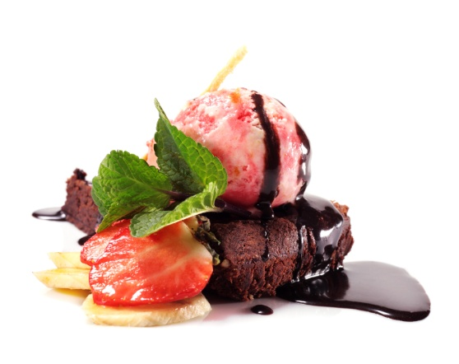
Prepare hot, cold and frozen dessert
Element 1:Prepare and produce a range of hot, cold and frozen desserts
Select required commodities according to recipe and production requirements
Prepare a variety of hot desserts according to standard recipes and enterprise standards
Prepare a range of cold desserts according to standard recipes and enterprise standards
Prepare a range of frozen desserts according to standard recipes and enterprise standards
Cont’
Notes:
Trainer to discuss:
Performance criteria relating to Element 1
The element is the skill
To assess competency in the skill; the performance criteria is used to outline activities that can be used to assess competency.
The trainer should relate how the performance criteria is related to the element
To be able to prepare hot, cold and frozen desserts the students must be able to Prepare and produce a range of hot, cold and frozen desserts
The students must be able to:
Select required commodities according to recipe and production requirements
Prepare a variety of hot desserts according to standard recipes and enterprise standards
Prepare a range of cold desserts according to standard recipes and enterprise standards
Prepare a range of frozen desserts according to standard recipes and enterprise standards.

Slide 5
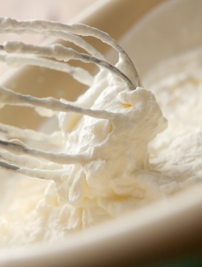
Prepare hot, cold and frozen dessert
Element 1:Prepare and produce a range of hot, cold and frozen desserts
Use appropriate equipment to prepare hot, cold and frozen desserts
Use correct techniques to produce hot, cold and frozen desserts to enterprise standards
Produce hot, cold and frozen desserts to enterprise requirements and standards
Select correct cooking conditions for hot, cold and frozen desserts
Notes:
Trainer to discuss:
Performance criteria relating to Element 1
The element is the skill
To assess competency in the skill; the performance criteria is used to outline activities that can be used to assess competency.
The trainer should relate how the performance criteria is related to the element
To be able to prepare hot, cold and frozen desserts the students must be able to Prepare and produce a range of hot, cold and frozen desserts
The students must be able to:
Use appropriate equipment to prepare hot, cold and frozen desserts
Use correct techniques to produce hot, cold and frozen desserts to enterprise standards
Produce hot, cold and frozen desserts to enterprise requirements and standards
Select correct cooking conditions for hot, cold and frozen desserts.

Slide 6
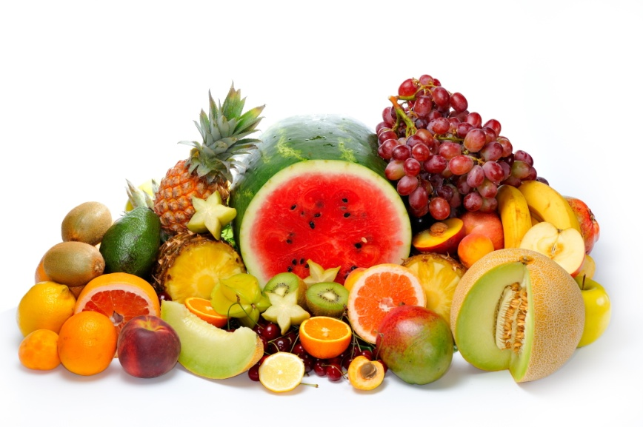
Prepare and produce a range of hot, cold and frozen desserts
Select commodities required:
Sugar
Cream
Eggs
Milk
Wine
Fruit
Nuts
Butter or fats
Notes:
Trainer to discuss:
Sugar
Caster sugar is the best to use here for its ability to dissolve. Other sugars can be used to add interest
Cream
Thickened cream is most versatile here. It can be whipped, boiled, has better mouthfeel.
Fruit
Fresh fruits, canned and frozen fruits
Nuts
Any nuts can be used, whole sliced nibbed slivered ground
Sponge, Cake, Meringue, Japonaise
Collection of these are required not make desserts, not flour, fat sugar
Fats
These will be either solid or liquid. Many desserts are deep fried so oil for deep frying becomes a commodity even though it might not be in recipe

Slide 7

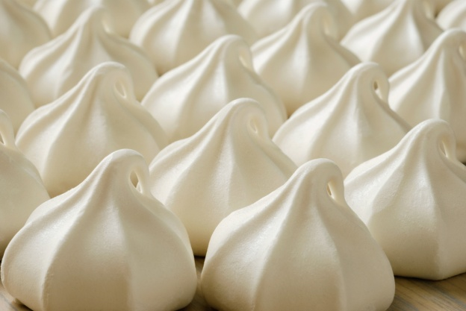
Prepare and produce a range of hot, cold and frozen desserts
Select commodities required:
Sponge
Cake
Meringue
Shortbread
Flavourings
Notes:
Trainer to discuss:
At this stage the pastrycook does not look for flour sugar eggs to make bases for desserts , they look for commodities like sponge, cake meringue products
How can this products be ‘value added’ to produce ‘a grand finale’ that will excite the customer.

Slide 8
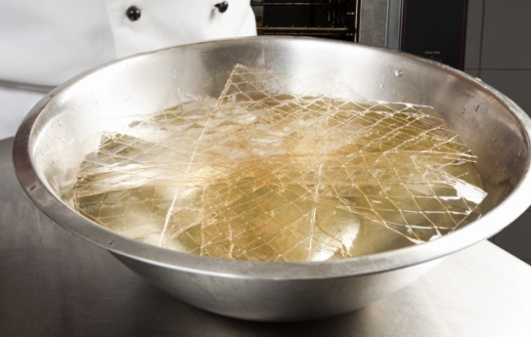
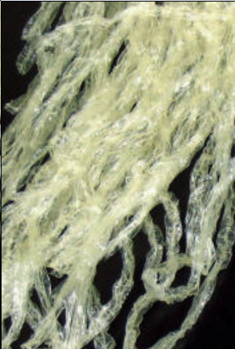
Prepare and produce a range of hot, cold and frozen desserts
Select commodities required:
Setting agents:
Gelatine
Agar agar
Vegetable gums
Starches
Notes:
Trainer to discuss:
Setting agents
Most cream based desserts will have cream and the cream will have a setting agent to hold shape.
The desserts will have been aerated so the setting agent so the setting agent is imperative to hold shape
Gelatin
The most common setting agent found in desserts, not just cream desserts.
Derived from animal hides and bones it has been the most common gelling or setting agent in European style desserts for many years.
Agar agar
Derived from seaweed and very strong setting agent. Popular in Asian recipes
Vegetable gums
Derived from seaweed and other vegetable sources. Becoming more available to the market as new style recipes and techniques are developed for the culinary market.
Gels and spherification powders in avante garde cookery are becoming more mainstream
Starches
Cooked starches from vegetable matter like wheat, rice and maize.
Used as powders and when cooked they will hold liquids in suspension.
Care must be taken with wheat starches as some people are ‘gluten intolerant’ and other starches must be used
All starches have different strengths so recipe modification may need to be developed.

Slide 9
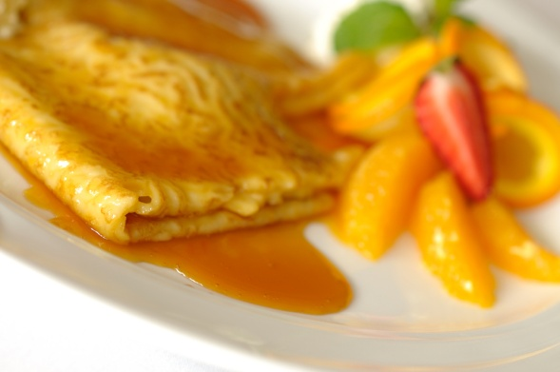
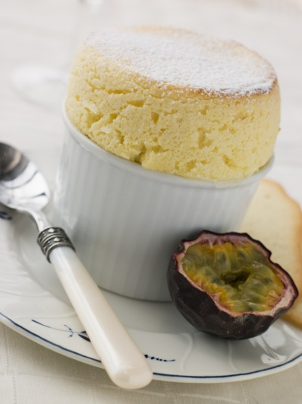
Prepare and produce a range of hot, cold and frozen desserts
Prepare a range of Hot Desserts:
Souffles
Puddings
Pies
Crepes
Notes:
Trainer to discuss:
Desserts come in many forms, Hot, Cold, Frozen and Room temperature. Some desserts can be sold in several guises. Hot and cold. Frozen or chilled.
Warm or frozen??????? Yes. Italian Zablione. This can be served warm for breakfast of frozen as a dessert.
Souffle, baked or chilled , frozen
Classic French baked souffle: Served hot and is very fragile, has a small window to be served, within 30 seconds. After this time product quality diminishes.
Best profit maker on menu. Minimal ingredients, maximum skill, maximum profit
Chilled or frozen is a flavoured and aerated egg and cream dessert engineered to look like a baked souffle.
Puddings:
Heavy cake style dessert favoured in cold climates as hot desserts are more popular. Generally served with hot sauces or custards.
Pies
Pastry and fruit desserts can be served hot or cold or room temperature. Popular in most western countries for ease of handling. Most fruits can be used in production
Crepes or French pancake. Very thin and fine in texture hence the name crepe, crepinette or caul.
Classic French dessert. Can be soft or crispy. Normandy crepes are crispy. Can be savoury or sweet dish
Pancakes
English style is thicker than the French. American flapjack or pancake served for breakfast or dinner.

Slide 10
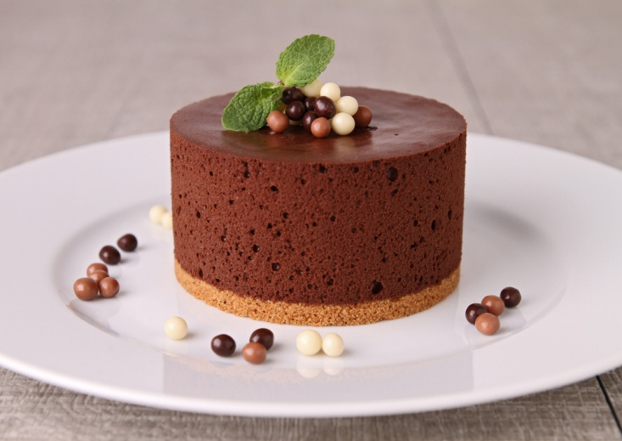
Prepare and produce a range of hot, cold and frozen desserts
Prepare a range of Cold Desserts:
Pies
Fruit salads
Pastries
Mousses
Bavarois
Notes:
Trainer to discuss:
Fruit pies can be served hot , room temperature or chilled
Shortbread with fruit filling
Some fruit tarts with cream patisserie and fruit on top are popular cold desserts
Summer puddings. Berries encased in stale bread
Apple strudel can be hot or cold
Fruit or fruit salads can be simple and easy to prepare
Flavoured Cream desserts such as bavarois, mousse. Variations are limitless. Need to be kept chilled

Slide 11
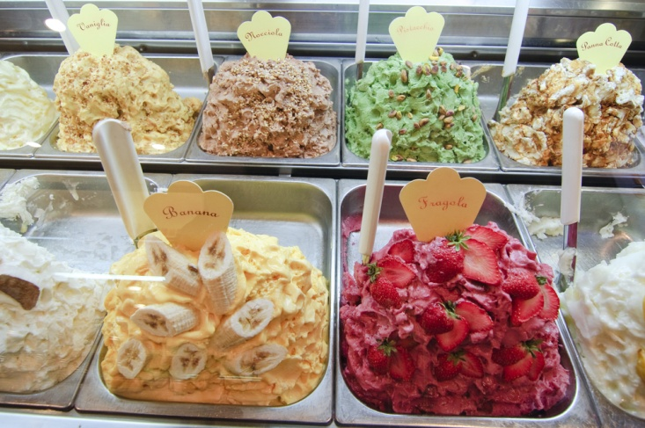
Prepare and produce a range of hot, cold and frozen desserts
Prepare a range of Frozen Desserts:
Ice cream
Sorbets
Parfaits
Notes:
Trainer to discuss:
Variations of these classic desserts are limitless
Deep Fried Ice cream????? Easy to produce, difficult to execute
Sorbets: sugar water and fruit purees
Parfaits: Aerated egg and flavoured cream mixtures frozen to shape then cut per serve. Variations are limitless.

Slide 12
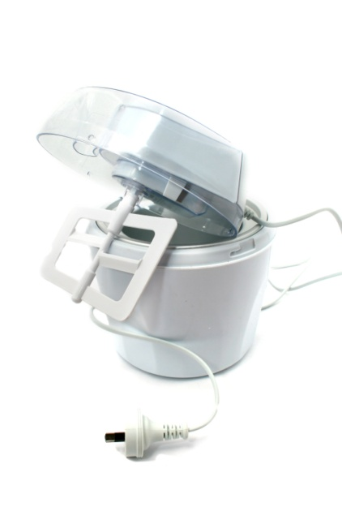
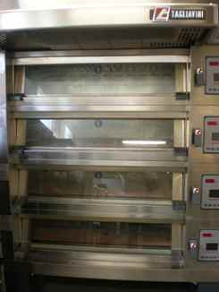
Prepare and produce a range of hot, cold and frozen desserts
Use Appropriate equipment:
Blast chillers
Ice cream machines
Ovens
Mixers
Freezers
Chillers
Notes:
Trainer to discuss:
Equipment for desserts is similar to general patisserie equipment but the freezer is utilised more for the frozen desserts.
Churning equipment to produce ice creams and sorbets
Ingredient still need to be mixed
Product still needs to be baked
Temperature of product is important
Freezers for storage of frozen product -18°C
Freezers for serving frozen desserts -12°C
Refer Students to Work Projects.

Slide 13
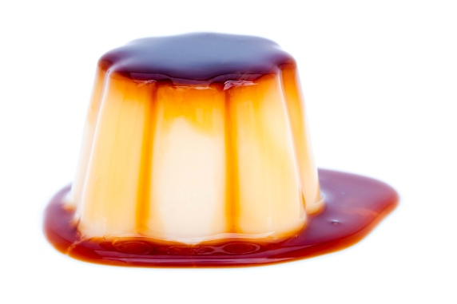
Prepare and produce hot, cold and frozen desserts
Element 2: Prepare and store sweet sauces
Select required commodities according to recipe and production requirements
Prepare and produce a range of sweet sauces to enterprise requirements and standards
Store sweet sauces for use in a service period or for use at another occasion
Notes:
Trainer to discuss:
Performance criteria that relates to element 2
The element is the skill
To assess competency in the skill; the performance criteria is used to outline activities that can be used to assess competency.
The trainer should relate how the performance criteria is related to the element
To be able to prepare hot, cold and frozen desserts the students must be able to; Prepare and store sweet sauces
The student must be able to do;
Select required commodities according to recipe and production requirements
Prepare and produce a range of sweet sauces to enterprise requirements and standards
Store sweet sauces for use in a service period or for use at another occasion

Slide 14
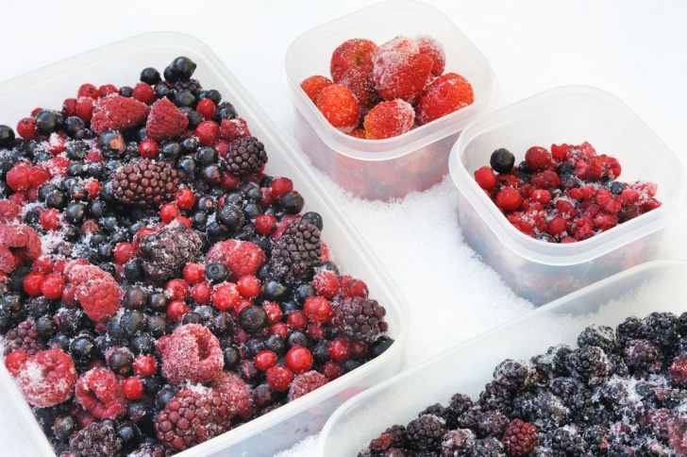
Prepare and store sweet sauces
Select commodities:
Sugar
Fruits
Starches
Gelling agents
Spices
Eggs
Aromatics
Notes:
Trainer to discuss:
All sweet sauces will contain sugar. Even fruits will have some sugar included or added.
Fruit salad (fresh fruit cut to order) is about the only dessert that will not have sugar added. Some people will add sugar syrup to this to keep moist.
Basis of all coulis will be fruit
Starches are used to thicken sauces
Gelling agents will be used to stabilise fruits sauces and cream desserts
Spices- might be used to flavour and may be served in sauce
Aromatics may be used to flavour but would be removed before sauce is served
E.ggs, used to thicken sauce Anglaise

Slide 15
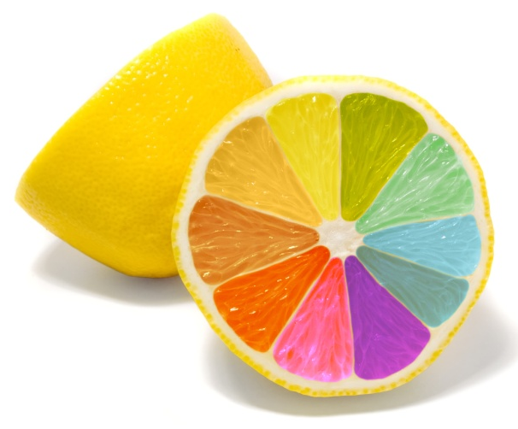
Prepare and store sweet sauces
Prepare and produce a range of sweet sauces to enterprise requirements and standards:
Enterprise requirements or standards
What is a standard?
What is a requirement?
Flavours: natural or artificial
Coloured: natural or artificial
Colour: intense or light
Notes:
Trainer to discuss:
Enterprise standards:
Each enterprise will have different standards for different requirement to other enterprises.
Standards need to be stated by the enterprise then that level needs to be adhered
Enterprise requirements will also change
Enterprise requirements will relate to size of product and price charged for portion
Some enterprises may cut product into 8 portions, others will cut into 12 portions. Same product different requirements.
May relate to shape, round or square
How intense is the colour red in icing

Slide 16

Prepare and store sweet sauces
Store sweet sauces for use in a service period
Store in clean food safe containers
Keep separate form older sauces
Never top up old sauce
Never put old sauce into new sauce
Keep in controlled environment
Notes:
Trainer to discuss:
Always use clean food safe containers to store prepared sauces
Never put old sauce into new sauce as any fermentation of sugars or bacterial activity will continue in the new sauce
Always store sauces in a controlled environment; chilled below 5 degrees Celcius

Slide 17

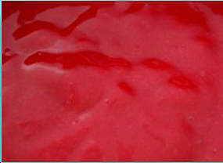

Prepare and store sweet sauces
Store sweet sauces for another occasion
Make sauces in batches
Label and date when stored
Attach use by date
Store in controlled environment:
Chilled
Frozen
Notes:
Trainer to discuss:
Sauce tend to be made up in batches and chilled until required.
If they are going to be used at a later date then they may need to be chilled for short time period; frozen for long time period of storage
All store products need to be labeled correctly

Slide 18
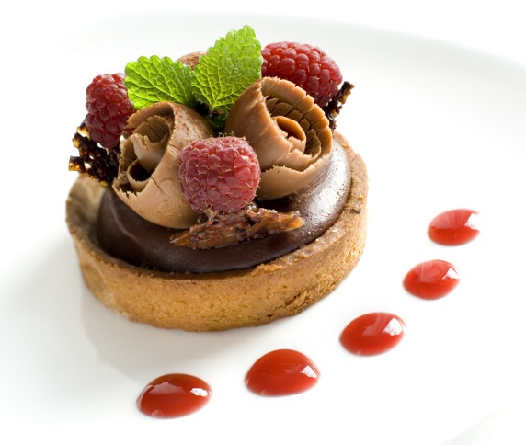
Prepare hot cold and frozen desserts
Element 3: Prepare accompaniments, garnishes and decorations
Plan accompaniments, garnishes and decorations for desserts
Prepare accompaniments, garnishes and decorations for desserts
Notes:
Trainer to discuss:
Performance criteria for element 3
The element is the skill
To assess competency in the skill; the performance criteria is used to outline activities that can be used to assess competency.
The trainer should relate how the performance criteria is related to the element
To be able to prepare hot, cold and frozen desserts the students must be able to; Prepare accompaniments, garnishes and decorations
Plan accompaniments, garnishes and decorations for desserts
Prepare accompaniments, garnishes and decorations for desserts.

Slide 19
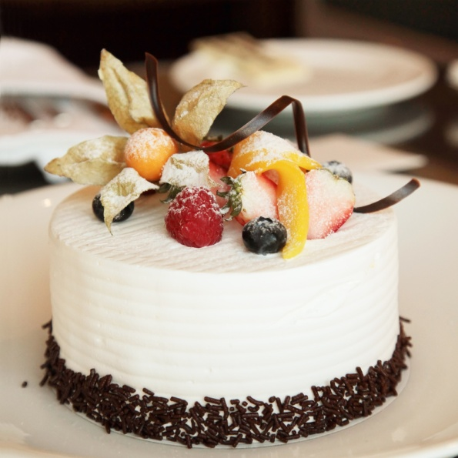
Prepare hot cold and frozen desserts
Plan accompaniments, garnishes and decorations
Stencils
Shortbread
Fruits
Sugar
Notes:
Trainer to discuss:
Garnishes and decorations
Most garnishes are made to decorate the dessert.
Small shortbreads or biscotti
Chocolate shapes
Boiled sugar shapes
Garnish can be as simple strawberry cut in half with mint leaf
This is popular due to the colour contrast on the plate
More elaborate item will take time and skill
Look in published books as listed in recommended reading has good references for stencils: The Professional Pastry chef; Author Bo friberg

Slide 20
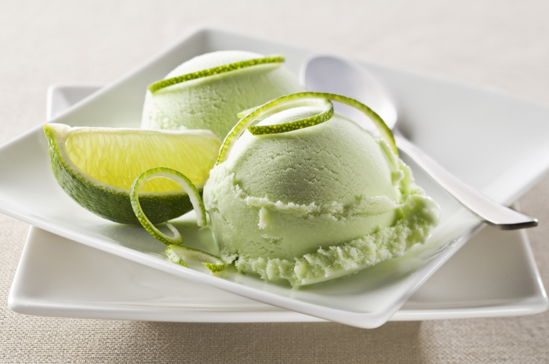
Prepare hot cold and frozen desserts
Prepare accompaniments, garnishes and decorations
Notes:
Trainer to discuss:
Select a simple recipe and gather as much understanding of the technique required
In beginning: keep it simple
More elaborate garnish the more skill required and more time needed.
Keep simple

Slide 21
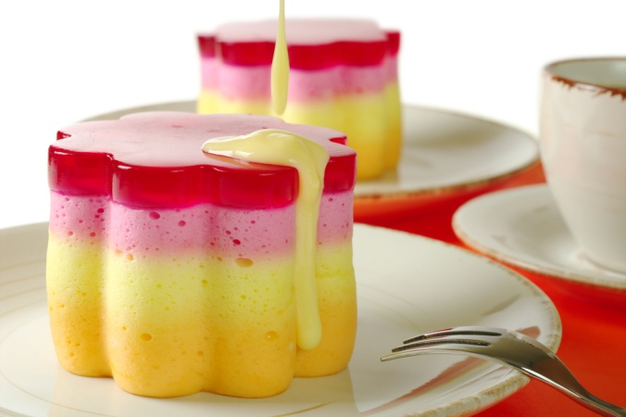
Prepare hot cold and frozen desserts
Element 4: Store Hot, cold and frozen desserts
Store desserts at appropriate temperature and conditions to maintain quality, freshness and customer appeal
Pack down desserts to ensure taste, appearance and textures are maintained
Notes:
Trainer to discuss:
Performance Criteria for Element 4
The element is the skill
To assess competency in the skill; the performance criteria is used to outline activities that can be used to assess competency.
The trainer should relate how the performance criteria is related to the element
To be able to prepare hot, cold and frozen desserts the students must be able to; Store hot, cold and frozen desserts
The student should be able to do
Store desserts at appropriate temperature and conditions to maintain quality, freshness and customer appeal
Pack down desserts to ensure taste, appearance and textures are maintained

Slide 22
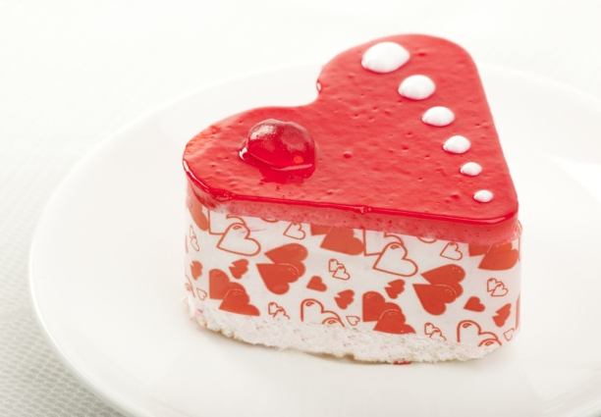
Store hot cold frozen desserts
Store desserts at appropriate temperatures
Store in controlled environment
Chilled
Frozen
Room temperature
Protected from outside contamination
Notes:
Trainer to discuss:
All desserts need to be stored in a controlled environment
Controlled environment:
Room temperature: protected form environment; stored in container, covered, wrapped
Chilled: less than 4ºC. can only be stored at this temperature maximum 3 days. Then discard, do not freeze. Quality is diminished
Frozen: -18ºC for long term storage.

Slide 23
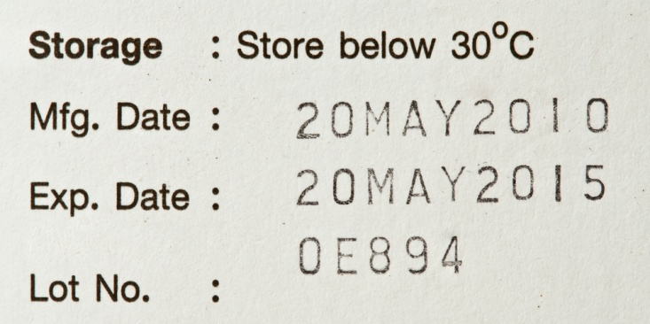
Store hot cold frozen desserts
Pack down desserts to ensure taste, appearance and textures are maintained
Store in secure containers
Label:
Date of manufacture
Use by date
Label example:
Notes:
Trainer to discuss:
Pack down??? Kitchen slang that means to store product to be used at another time
Store product to be used at another time
Integrity need to be in place
Store produce so it is not damaged.

Slide 24

Thank you
Notes:
Thank you

